Slide 1
HEALTH INFORMATION SYSTEM
CREATED BY RYAN MUGO GITHAIGA

Slide 2
Project Overview
This Health Information System is a Django-based web application that allows doctors to manage health programs and enrol clients into those programs.
It also exposes client profile information via an API for easy integration with other systems.

Slide 3
Key Features
- User Authentication (Login, Logout, Registration)
- Register New Clients
- View List of Clients
- Create, Edit, Delete, and View Health Programs (e.g., TB, Malaria, HIV programs)
- Enrol Clients into Programs
- REST API to expose Client Profile data (using Django REST Framework)

Slide 4
Technologies Used
- Django 5.2
- Django REST Framework
- Bootstrap 5 (for UI Styling)
- MySQL (Database)

Slide 5
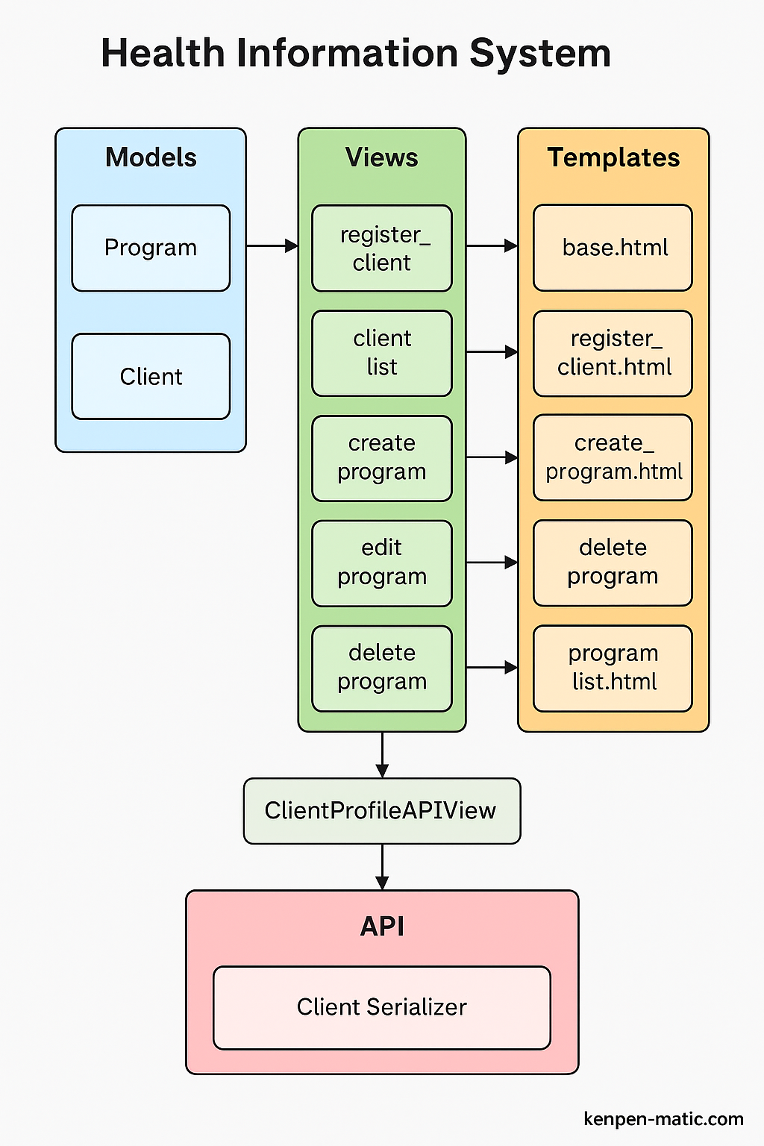
Health Information System Architecture Diagram

Slide 6
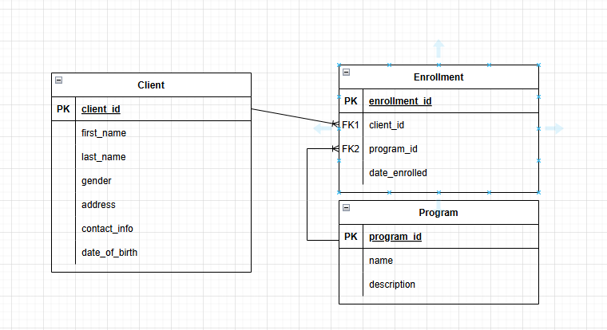
ENTITY RELATIONSHIP DIAGRAM FOR MySQL DATABASE

Slide 7
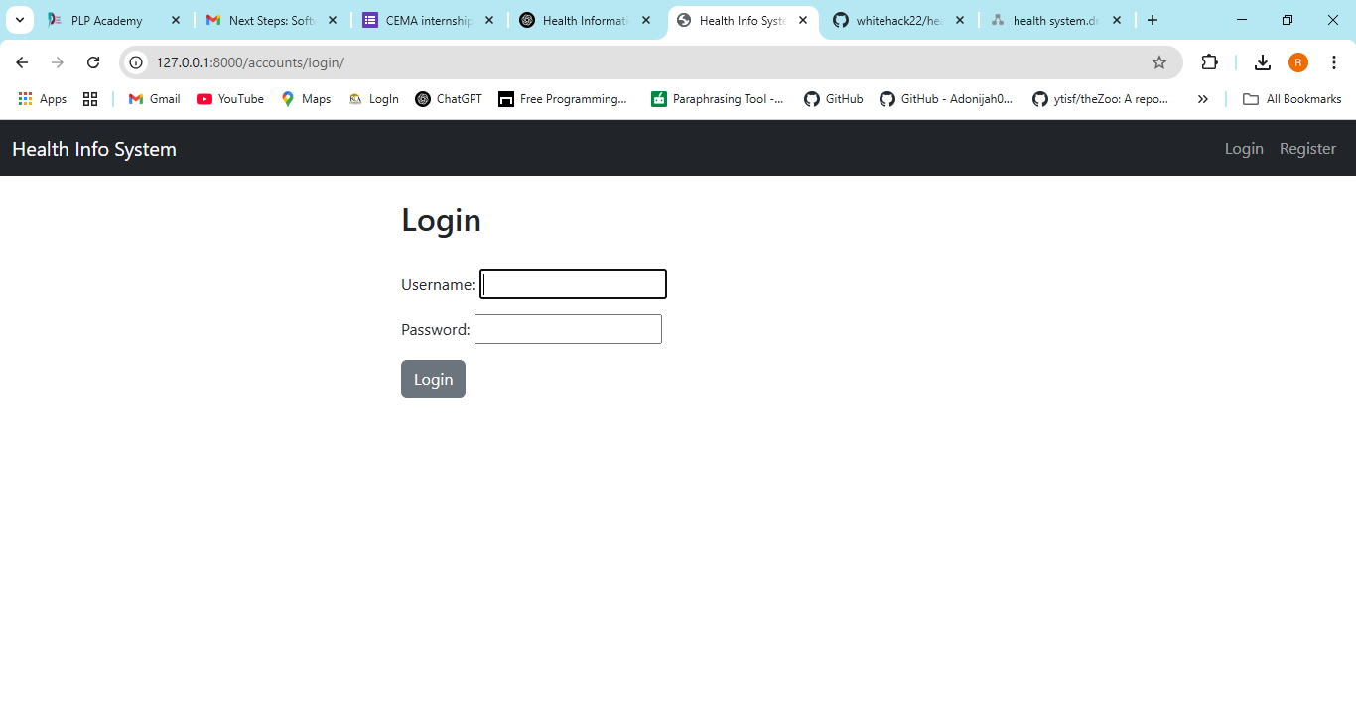
Screenshots of the System 1. Login Page

Slide 8
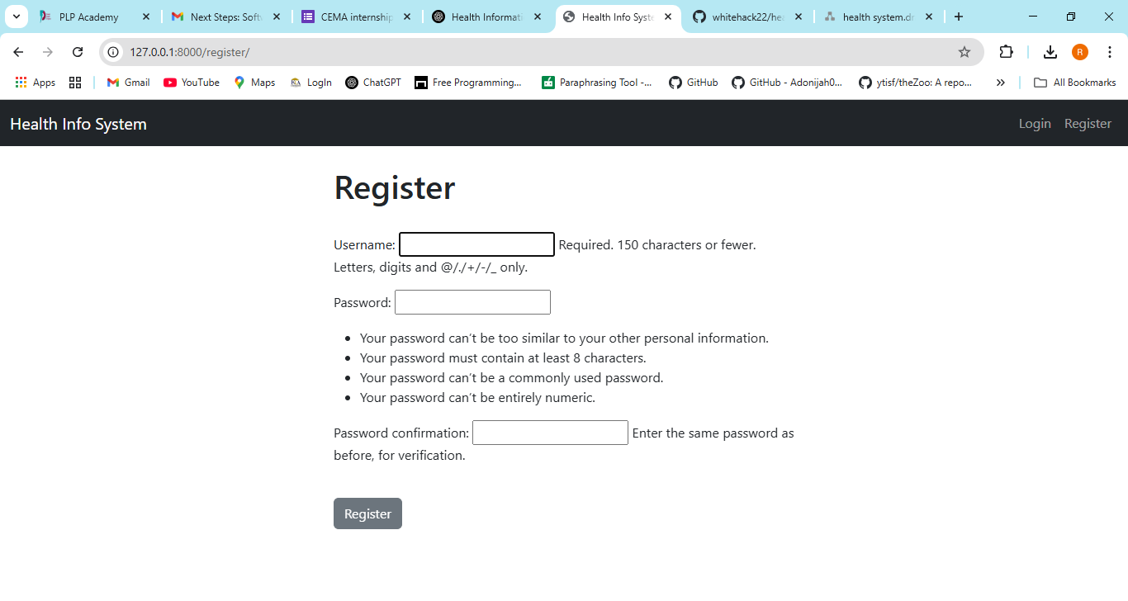
2. Register Page

Slide 9
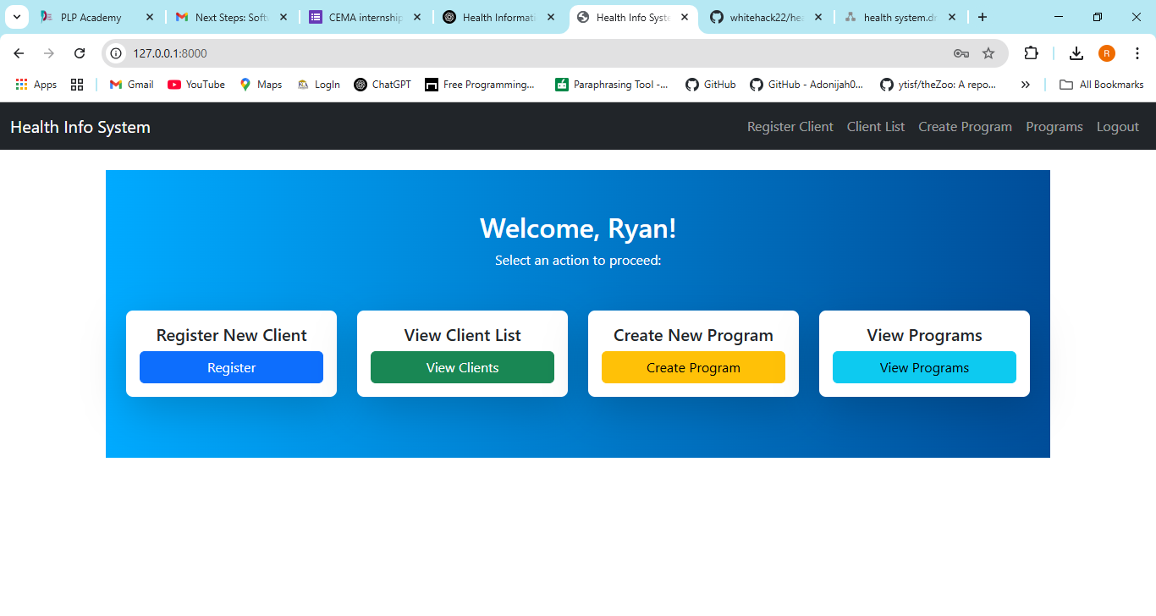
3. Home Page

Slide 10
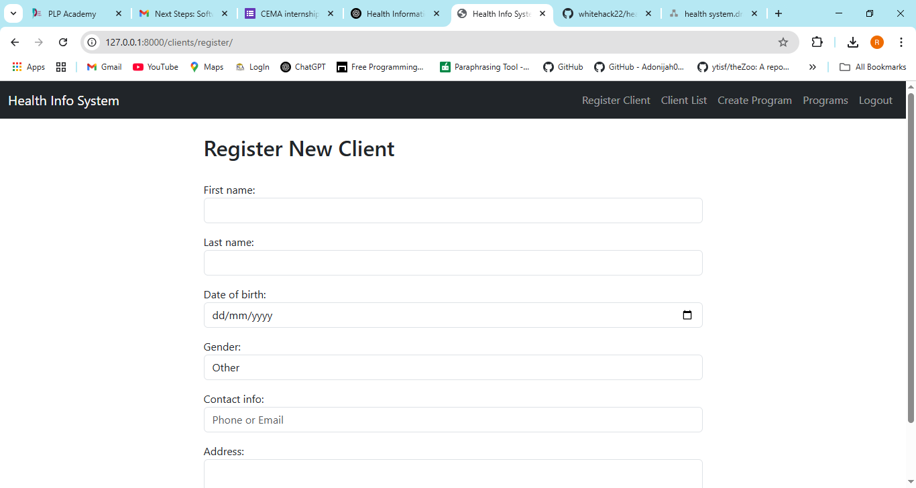
4. Register New Client

Slide 11
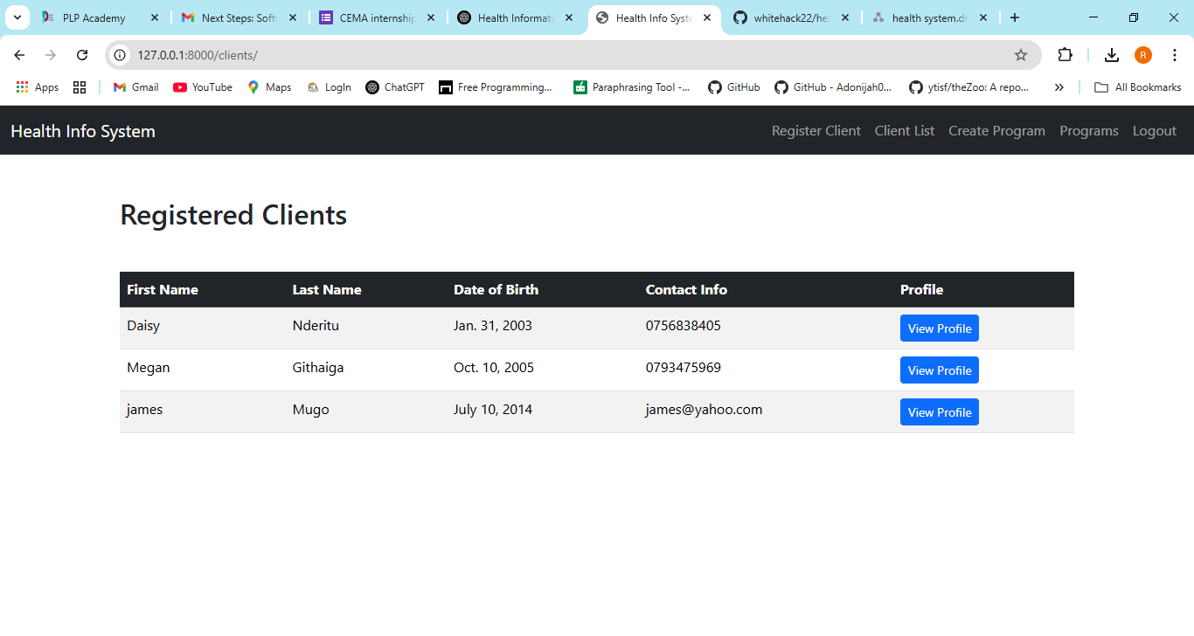
5. View Clients List

Slide 12
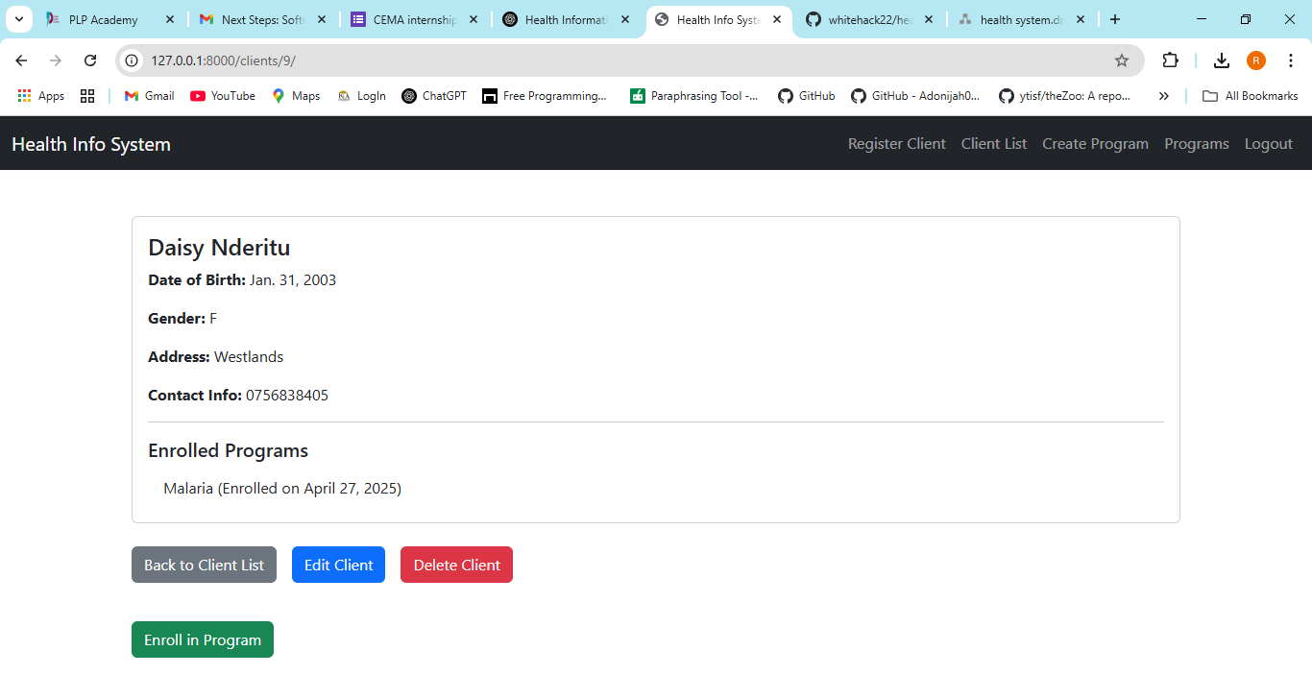
6. View Client’s Profile

Slide 13
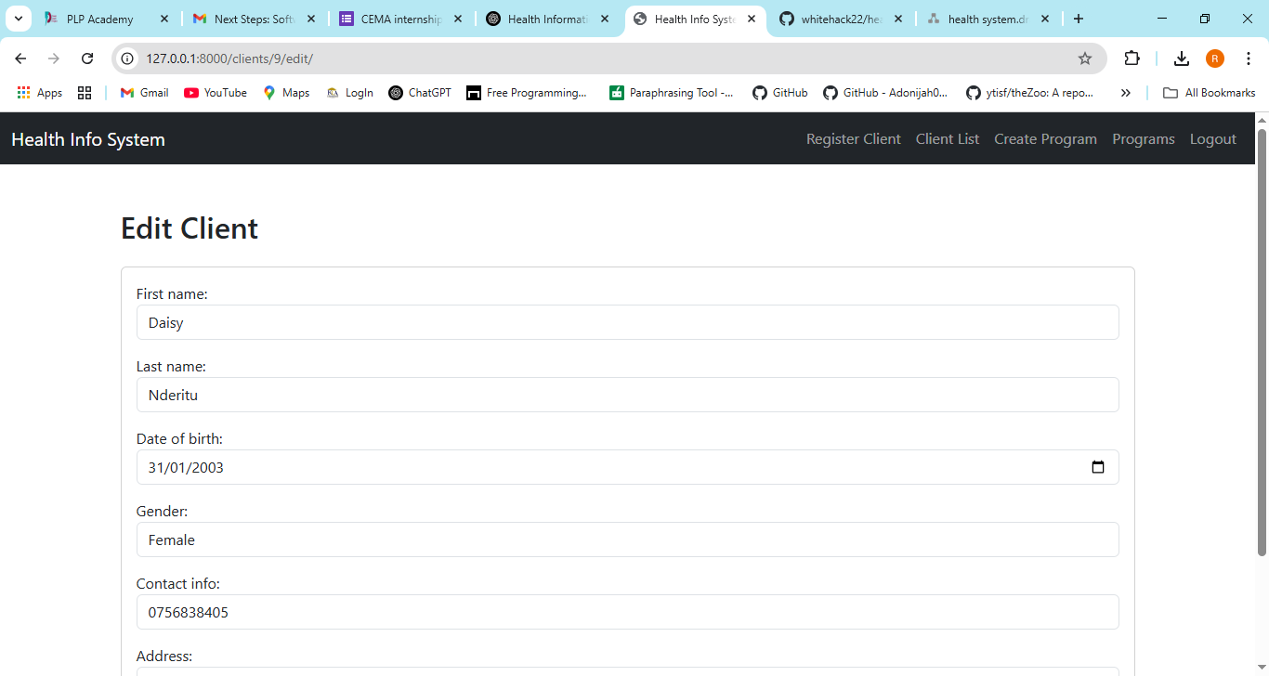
7. Edit Client’s Profile

Slide 14
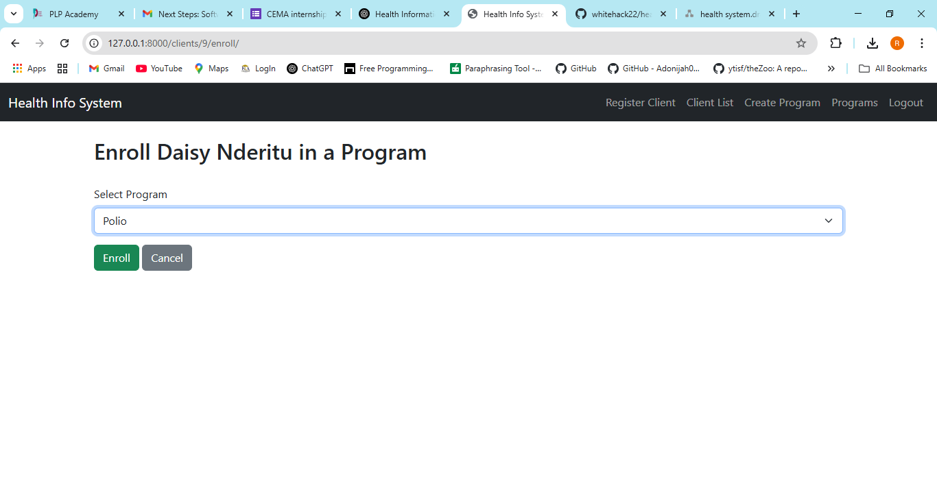
8. Enrol the Client into a new program

Slide 15
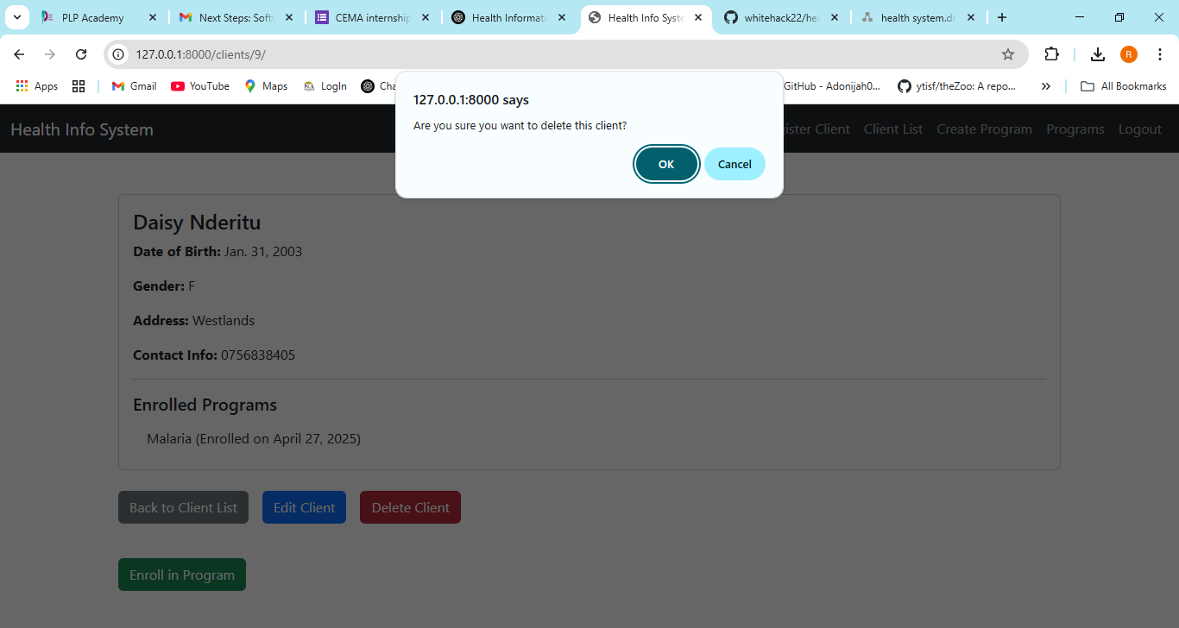
9. Delete a client from the system

Slide 16
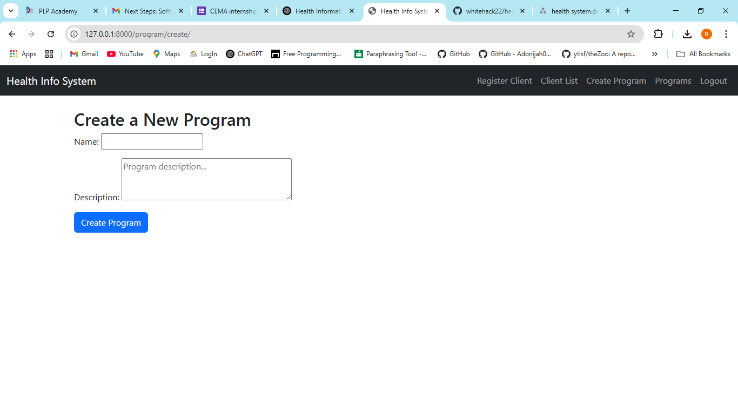
10. Create a new program

Slide 17
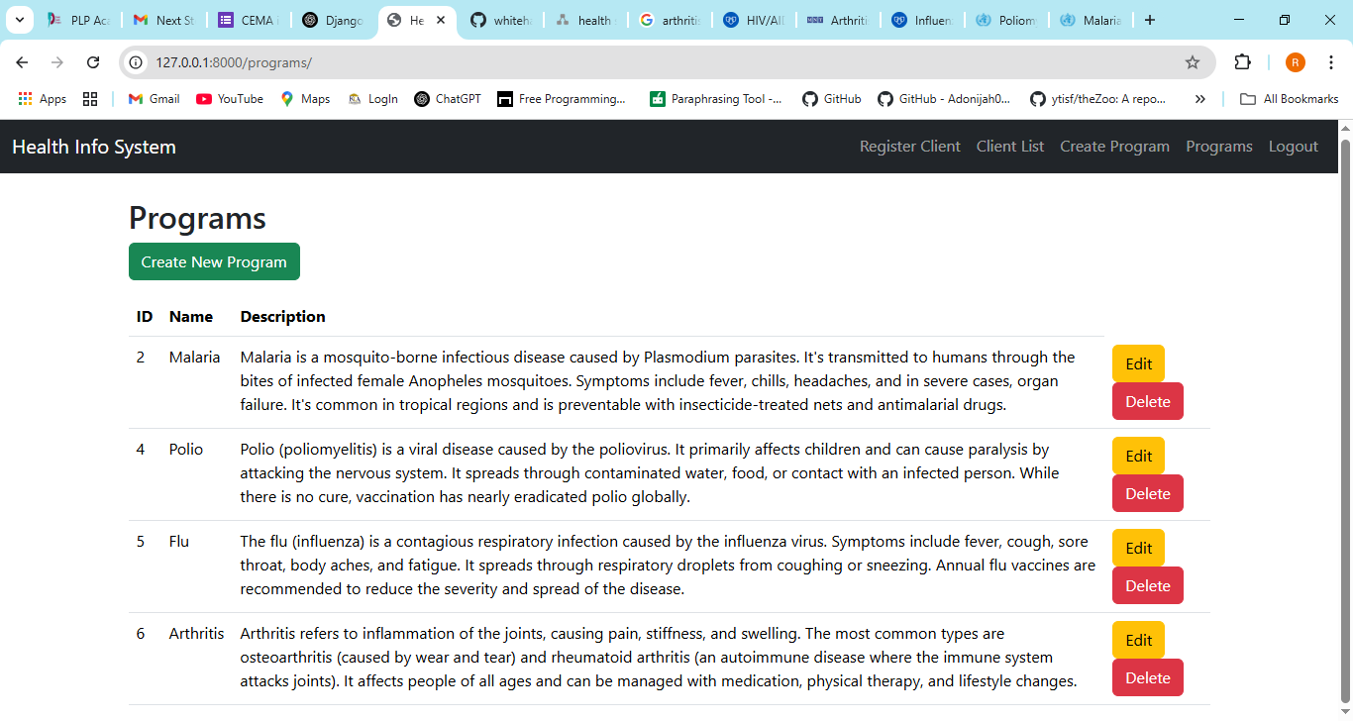
11. View existing programs

Slide 18
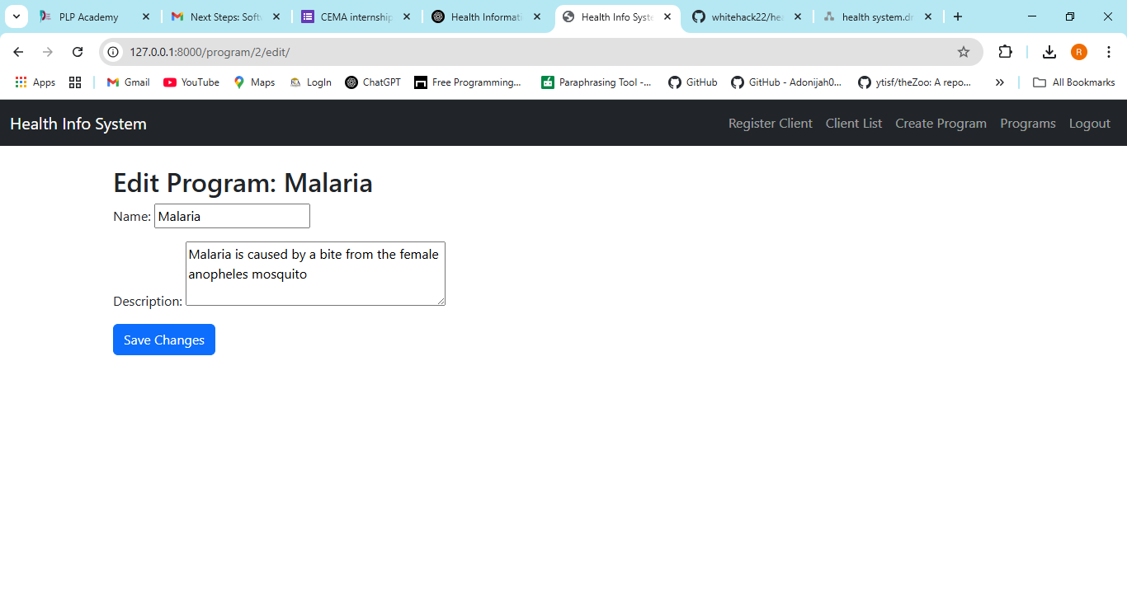
12. Edit an existing program

Slide 19
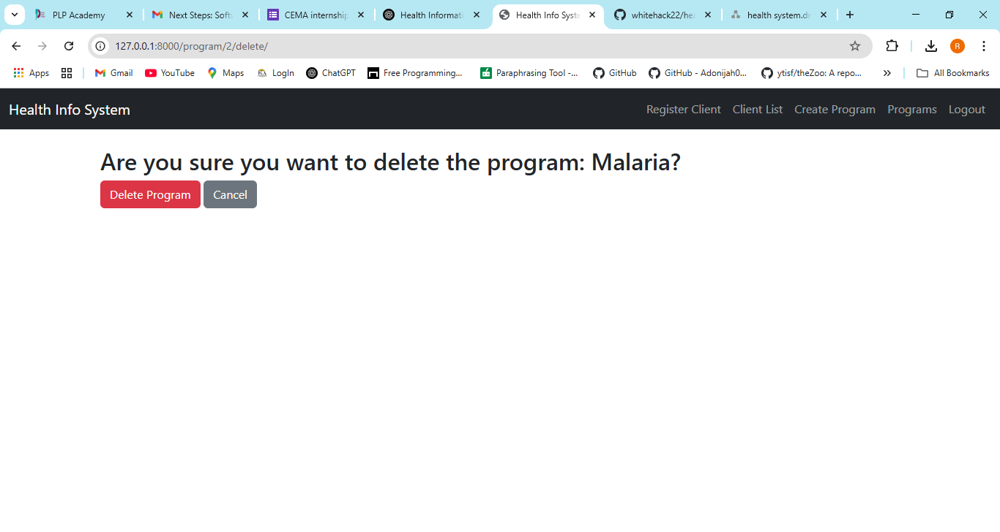
13. Deleting a program

Slide 20
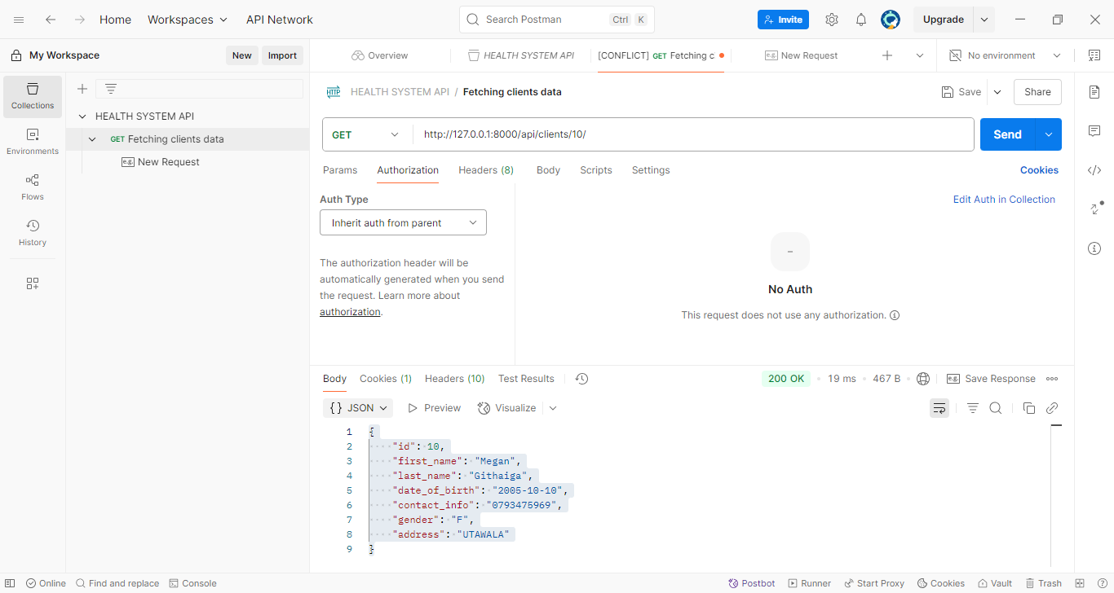
14. Fetching client details using POSTMAN API

